Slide 1
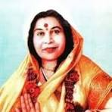
Introduction to Sahaja Yoga
Grade 1, Nirmala Vishwa Vidya Peetham (Home School)
Shri Mataji Nirmala Devi - The founder of Sahaja Yoga meditation
Notes:
Hi! My name is Virata! In this presentation I am going to give a short introduction to Sahaja yoga. I will explain about Sahaja Yoga, Kundalini energy, and about Self-Realization.

Slide 2
What is Sahaja Yoga?
In the words Sahaja Yoga, ‘Saha’ means ‘with’, ‘Ja’ means ‘born’, and ‘Yoga’ means union or connection with the universal energy or God or Mother Nature.
Sahaja yoga helps us easily awaken our inner energy called Kundalini to achieve this union and physically feel it as a cool breeze through a process called self-realization.
It is very simple and anybody can feel this experience.
Sahaja yoga is always free and is practiced in several countries around the world.
Shri Mataji Nirmala Devi is the founder of “Sahaja Yoga” meditation and has given this gift to humanity.
By practicing “Sahaja Yoga” meditation, we can always be joyful and peaceful, and achieve the highest state of human life.
Shri Mataji Nirmala Devi - the founder of Sahaja Yoga meditation

Slide 3
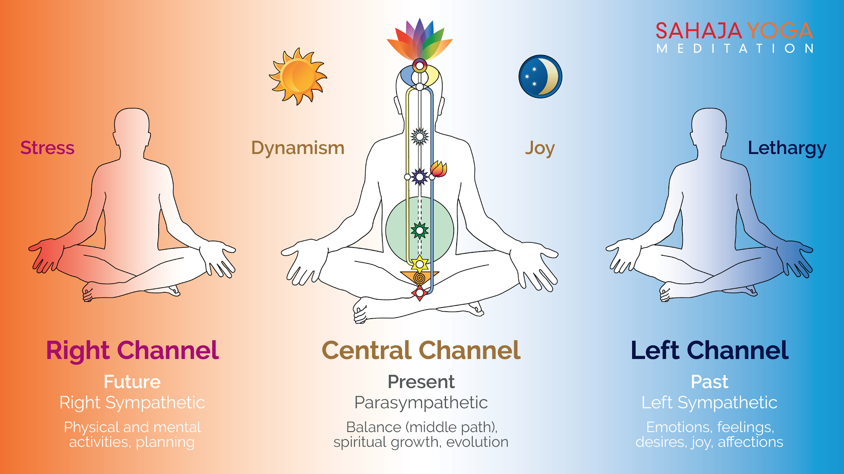
Chakras and Channels
Chakras:
Chakras are like energy centers located near different parts of our spinal cord, and control our physical and mental states.
There are seven chakras in our body:
Mooladhara, Swadhisthana, Nabhi (Void), Anahata, Vishuddhi, Agnya, and Sahastrara.
Each chakra helps maintain different emotional and mental qualities. It also takes care of physical organs around it.
When our chakras are in balance, we will be healthy physically and mentally.
Sahaja Yoga guides us on how to take care of our seven chakras.

Slide 4
Chakras and Channels
Channels:
There are 3 Channels within us which control our past, present and future activities.
Left channel or Moon channel (Past) – Takes care of our desires, emotions and feelings.
Right channel or Sun channel (Future) – Takes care of our planning, physical and mental activities.
Center Channel (Present) – Takes care of our spiritual growth and maintaining balance.

Slide 5
Self-Realization
Kundalini energy:
Kundalini energy is motherly energy inside us.
It is in the bottom of the spinal cord in a triangular bone called sacrum bone.
It stays in a dormant state.
Self-Realization:
When our Kundalini energy rises, and passes through all the chakras, and reaches the chakra on top of our head, and gets connected with the divine energy around us, this is called Self-Realization.
We can feel this in our hands, and on top of our head as a cool breeze.

Slide 6
Benefits
When we practice Sahaja Yoga meditation everyday morning and evening (around 5 to 10 minutes), and meditate in a group (called as collective meditation) at least once a week, it helps us in many ways:
The main benefit is that we will be always connected to God, or the Universal energy.
It cures all physical, mental, and emotional problems.
It makes us peaceful and always keeps us in balance.
It balances our chakras which improve the qualities associated with those chakras within us. For example, when the swadisthana (2nd chakra) gets balanced, our creativity improves (and reflects in various forms such as singing, dancing, painting, etc.)
It gives us good health, and happiness.
It teaches us to help each other and enjoy as a group.
It will make us free from stress, and tensions.

Slide 7
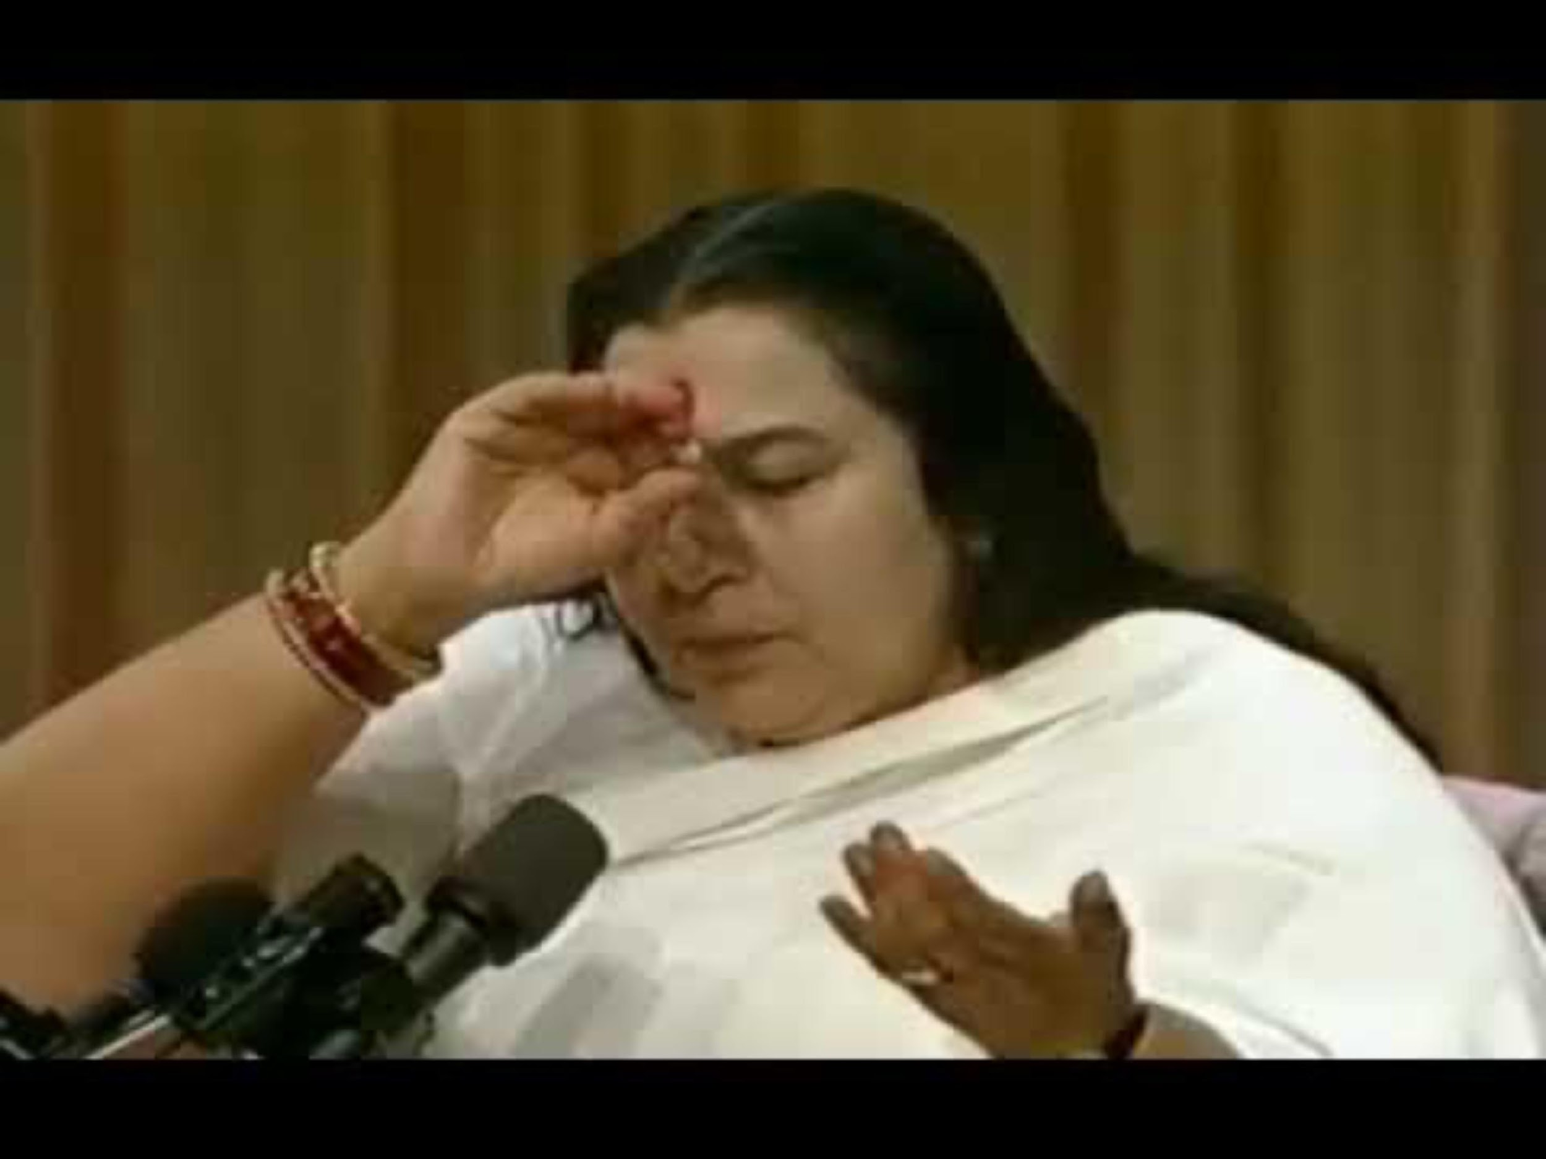
Experience Self-Realization by Shri Mataji

Slide 8
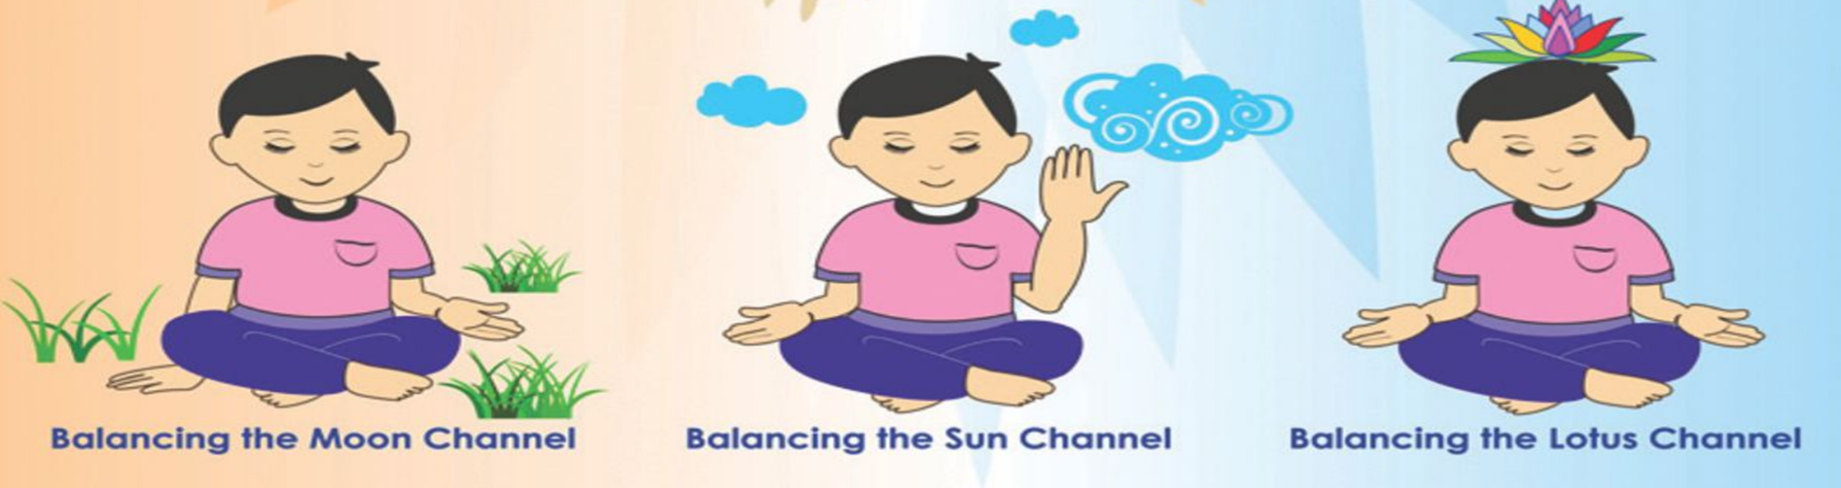
Daily meditation
We can follow these simple steps to remove imbalances and then sit in silent meditation for a few (~10) minutes to feel the cool breeze and peacefulness. This is called Meditation.
Mother Kundalini, please balance my Left channel
Mother Kundalini, please balance my Right channel
Mother Kundalini, please keep me in the present. Please give me self-realization.

Slide 9
Bandhan (uppy uppy)
Bandhan means rising our Kundalini energy.
We follow the steps below to rise our Kundalini energy in a bandhan:
Firstly, we keep our palms in facing us near the first chakra (below sacrum bone).
We move left palm from bottom of spine to top of our head. While doing this, the right palm moves around the left palm like making a circle around it (inside-out or clock-wise direction).
We do the above step 3 times, and we tie 1 knot on top of head for the first time, 2 knots the second time, and 3 knots the third time.
We now keep our left hand open on our lap and move the right hand from left hand to top of our head and then to the right like making a rainbow and then move back the same way from right side to left side.
We repeat the above step 7 times.
We should raise our kundalini and give bandhan every time before and after meditation.

Slide 10
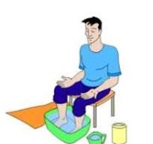
Foot-Soaking
Foot soaking is a method to cleanse our inner being using water element.
Steps (image shown on the right):
We fill a tub with clean water and add a handful of salt to it.
We keep a towel, and freshwater in a mug aside.
We sit on a chair and give bandhan to ourselves at the beginning of the meditation.
We keep our feet in the water tub to cleanse our left, right, and central channels (about 5-10 minutes).
After we are done, we wash our feet with freshwater and wipe with the towel.
We end by giving bandhan to ourself.
We can also light a candle in the room while doing this.
For best results, foot soaking can be done just before going to sleep.

Slide 11
Primordial Masters
Primordial masters (or Adi Gurus’) are born at different times and taught us principles to lead a dharmic life
They have also described about the experience and imprortance of self-realization
Below are the 10 primordial masters:
To know more about Adi Gurus’ and their life stories, please refer to the document below: https://drive.google.com/file/d/1hWysase1rEzrdwm5OVxhL8Svd1VOIO5W/view?usp=drivesdk
1. Raja Janaka (~5000 BC, Nepal) | 2. Abraham (~1800 &1600 BC, Mesopotamia)
3. Moses (~1300 BC, Egypt) | 4. Zarathoustra or Zoroaster (~630 BC, Persia)
5. Lao Zi or Lao Tzu (600 or 500 BC, China) | 6. Confucius (~551 BC, China)
7. Prophet Muhammad (~570 BC, Mecca) | 8. Socrates (~470 BC, Greece)
9. Guru Nanak (1469 AD, Punjab in Pakistan) | 10. Saïnath (~1854 AD, India)

Slide 12
Collective meditation & References
Collective meditation is very important because we can feel calmness, easily improve our meditation and learn techniques to keep us in balance.
Meditation-at-Home-Booklet - This short introductory booklet gives you more details about Sahaja Yoga and how you can meditate everyday.
To attend Sahaja Yoga collective meditation near your location, you can lookup ‘Sahajayoga <city/country> name’ in Google/Meetup.
More information about Sahaja Yoga and center locations can be found here:
sahajayoga.org
freemeditation.com
sahajayoga.org.in

Slide 13
Thank you!

Slide 14
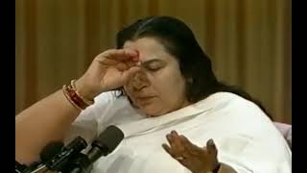
Old-Experience Self-Realization by Shri Mataji

Slide 15
Old - Chakras, Channels & Self-Realization
Chakras: Chakras are like energy centers located near different parts of our spinal cord, and control our physical and mental states. Sahaja Yoga guides us on how to take care of our seven chakras: Mooladhara, Swadhisthana, Nabhi (Void), Anahata, Vishuddhi, Agnya, and Sahastrara. When our chakras are in balance, we will be healthy physically and mentally.
.
Channels: There are 3 Channels within us which control our past, present and future activities.
Kundalini energy: Kundalini energy is motherly energy inside us. It’s in the bottom of the spinal cord in a triangular bone.
Self-Realization: When our Kundalini energy rises, and passes through all the chakras, and reaches the chakra on top of our head, and gets connected with the divine energy around us, this is called Self-Realization. We can feel this in our hands, and on top of our head as a cool breeze.

Slide 16
Old - Chakras and Channels
Chakras:
Chakras are like energy centers located near different parts of our spinal cord, and control our physical and mental states.
Sahaja Yoga guides us on how to take care of our seven chakras:
Mooladhara, Swadhisthana, Nabhi (Void), Anahata, Vishuddhi, Agnya, and Sahastrara.
Each When our chakras are in balance, we will be healthy physically and mentally.
Channels:
There are 3 Channels within us which control our past, present and future activities.
Left channel (Past) – Takes care of our desires, emotions and feelings.
Right channel (Future) – Takes care of our planning, physical and mental activities.
Center Channel (Present) – Takes care of our spiritual growth and maintaining balance.

Slide 17
Old - Bandhan (uppy uppy), and foot-soaking:
Bandhan:
Bandhan means rising our Kundalini energy
We follow the steps below to rise our Kundalini energy in a bandhan:
Firstly, we keep our palms in facing us near the first chakra.
We move left palm from bottom of spine to top of our head. While doing this, the right palm moves around the left palm like making a circle around it (clock-wise direction).
We do the above step 3 times and we tie 1 knot on top of head for the first time, 2 knots the second time, and 3 knots third time.
We now keep our left hand open on our lap and move the right hand from left hand to top of our head and then to the right like making a rainbow and then move back the same way from right side to left side.
We repeat the above step 7 times.
Foot-Soaking:
Foot soaking is a method to cleanse our inner being using water element.
We follow the steps mentioned below to perform Foot-Soaking:
We fill a tub with clean water and add salt to it.
We keep a towel, and freshwater aside.
We sit on a chair and give bandhan to ourselves at the beginning of the meditation
We keep our feet in the water tub to cleanse our left, right, and central channels (about 5-10 minutes as shown in image below)
After we are done, we wash our feet with freshwater and wipe with the towel.
We end by giving bandhan to ourself.

Slide 18
Old - There are 10 Adi gurus (primordial Masters). We have to follow them to have dharmic life:
To see the Adi Gurus’ image, you can go to:
https://drive.google.com/file/d/1FPS5l3wjXnUhxHYi-mM2fuMwaAuOjxxe/ view?usp=drivesdk
To the Adi Gurus' stories, coloring, etc, you can go to:
https://drive.google.com/file/d/1hWysase1rEzrdwm5OVxhL8Svd1VOIO5W/ view?usp=drivesdk

